Slide 1



Machine Learning
Gradient Descent
ANWAR KHAN
University of Lahore

Slide 2







Gradient Descent (Optimization)
Gradient Descent
1847
1815
1613
1945 1956 1959 1974 1980 1987 1993
Human “Computers”
Linear & First programmable Turing Test Machine
₁rst _{AI}
2nd AI Winter
polynomial
machine
& AI Learning Winter
Ridge Regression
regression
Lasso
Regression

Slide 3
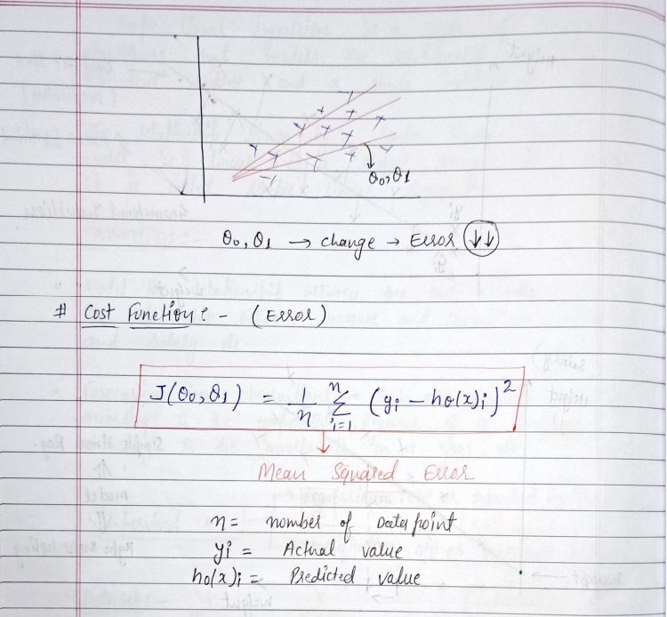
Introduction Intuition Cost Function and Gradient Descent LR with GD Python Polynomial Regression Tasks
Mathematical calculation
Regression

Slide 4
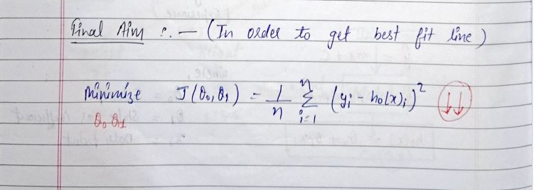
Introduction Intuition Cost Function and Gradient Descent LR with GD Python Polynomial Regression Tasks
Regression

Slide 5
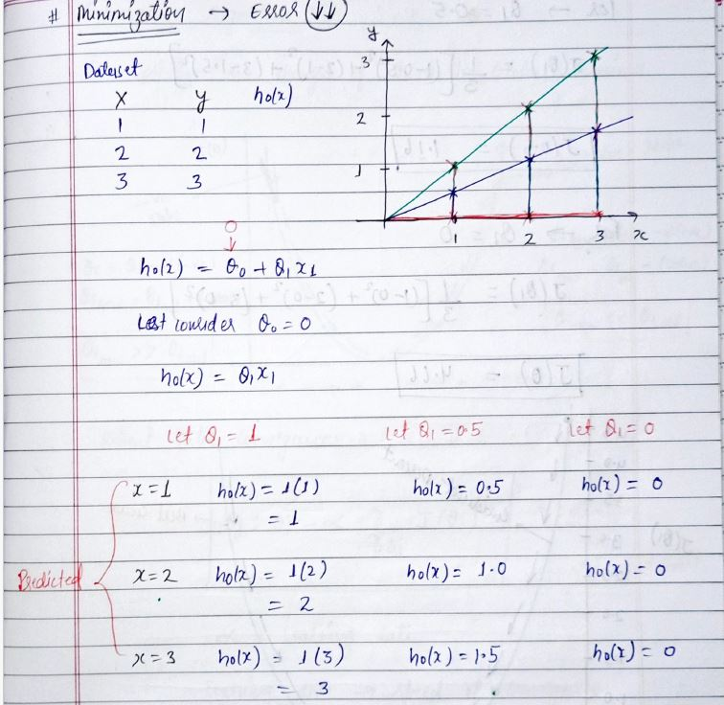
Introduction Intuition Cost Function and Gradient Descent LR with GD Python Polynomial Regression Tasks
Regression

Slide 6
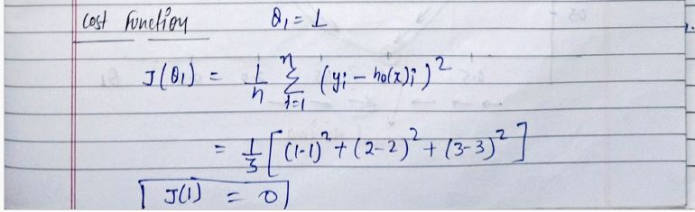
Introduction Intuition Cost Function and Gradient Descent LR with GD Python Polynomial Regression Tasks
Regression

Slide 7
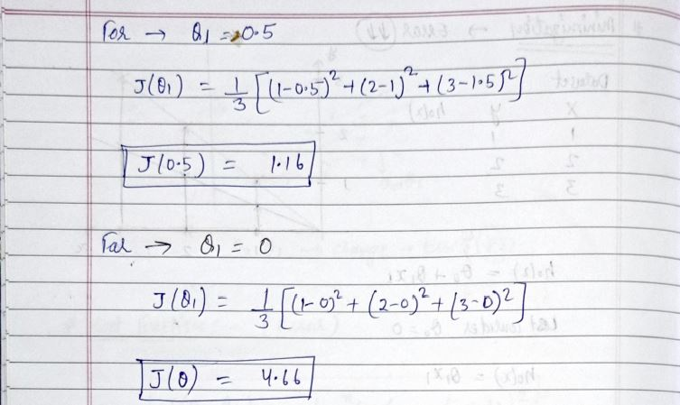
Introduction Intuition Cost Function and Gradient Descent LR with GD Python Polynomial Regression Tasks
Regression

Slide 8
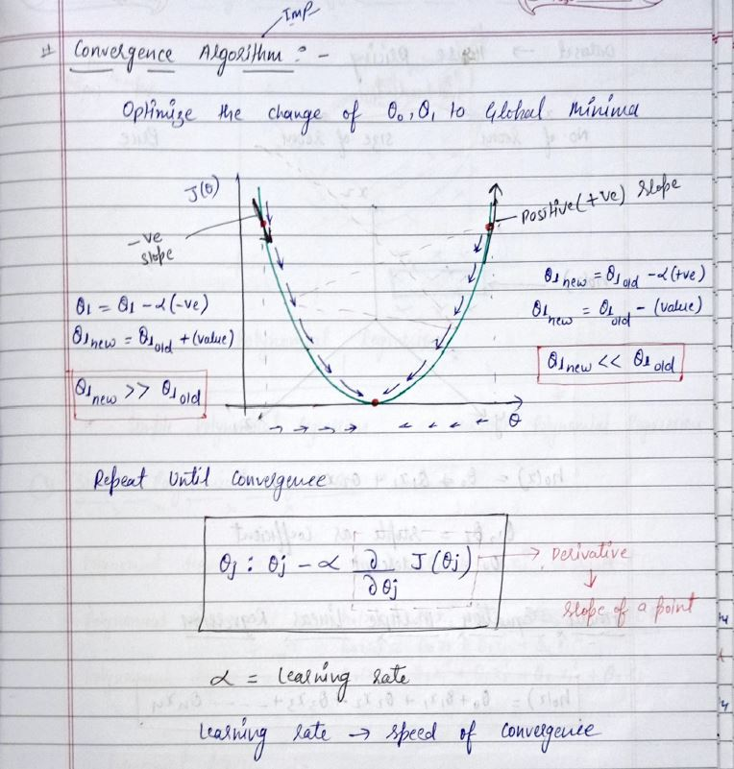
Introduction Intuition Cost Function and Gradient Descent LR with GD Python Polynomial Regression Tasks
Regression

Slide 9
Introduction Intuition Cost Function and Gradient Descent LR with GD Python Polynomial Regression Tasks
Gardient Descent
Gradient Descent is an optimization algorithm used for minimizing the cost function in various machine learning algorithms. It is basically used for updating the parameters of the learning model.
Lets i give you a example : Suppose you are lost in the mountains in a dense fog; you can only feel the slope of the ground below your feet. A good strategy to get to the bottom of the valley quickly is to go downhill in the direction of the steepest slope. This is exactly what Gradient Descent does: it measures the local gradient of the error function with regards to the parameter vector θ and it goes in the direction of descending gradient. Once the gradient is zero, you have reached a minimum!
Regression

Slide 10
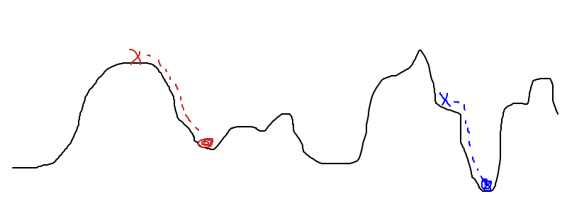

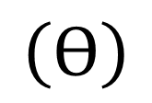
Hill-Descent
$$L\left(ϴ\right)$$
$$\left(ϴ\right)$$
“Climbing down from Everest in thick fog with amnesia"

Slide 11
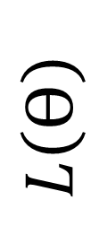
Hill-Descent
$$L\left(ϴ\right)$$
$$\left(ϴ\right)$$
Question 1: What we need to take a step downwards ?

Slide 12
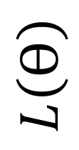
Hill-Descent
$$L\left(ϴ\right)$$
$$\left(ϴ\right)$$
Question 1: What we need to take a step downwards ?: Direction and step size

Slide 13
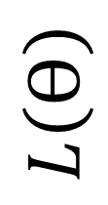

From Hill-Descent to Gradient-Descent
$$L\left(ϴ\right)$$
$$\left(ϴ\right)$$
Question 2: How do we find direction of decreasing $L\left(ϴ\right)$?: $\frac{∂(L\left(ϴ\right))}{∂\left(ϴ\right)}$

Slide 14



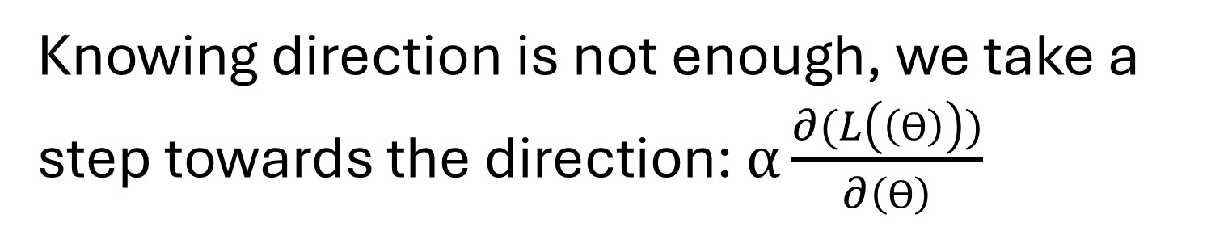

From Hill-Descent to Gradient-Descent
$$α$$
$$L\left(ϴ\right)$$
$$\frac{∂(L\left(ϴ\right))}{∂\left(ϴ\right)}$$
$$W$$
Knowing direction is not enough, we take a step towards the direction: $α\frac{∂(L\left(\left(ϴ\right)\right))}{∂\left(ϴ\right)}$

Slide 15

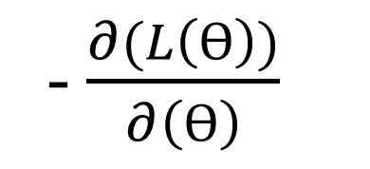
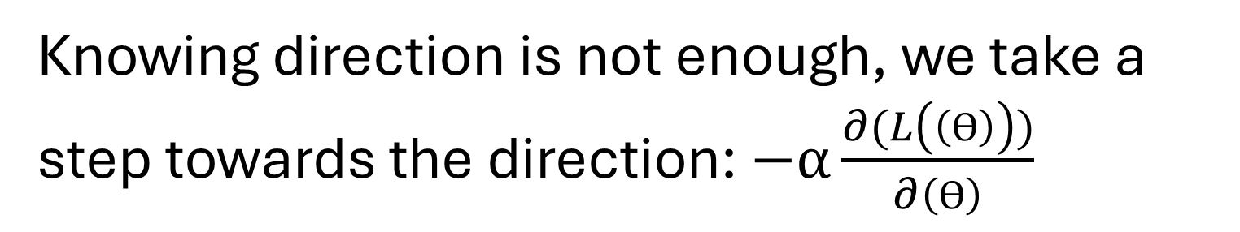
From Hill-Descent to Gradient-Descent
$$α$$
$$L\left(ϴ\right)$$
- $\frac{∂(L\left(ϴ\right))}{∂\left(ϴ\right)}$
$$\left(ϴ\right)$$
Knowing direction is not enough, we take a step towards the direction: $−α\frac{∂(L\left(\left(ϴ\right)\right))}{∂\left(ϴ\right)}$

Slide 16
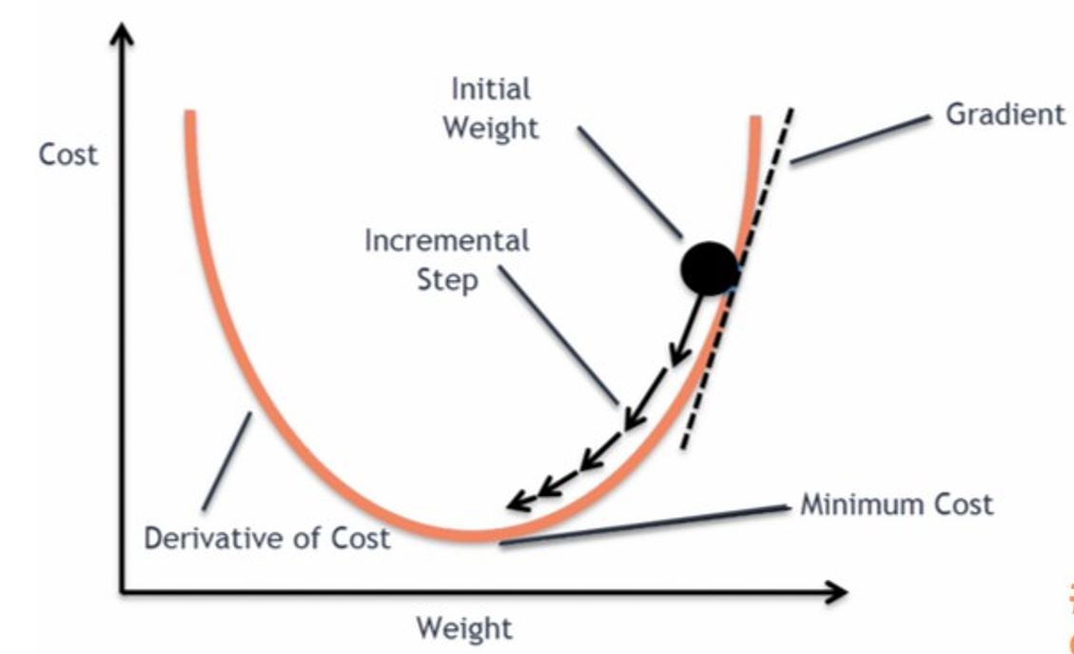
Introduction Intuition Cost Function and Gradient Descent LR with GD Python Polynomial Regression Tasks
Regression

Slide 17
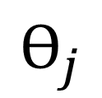
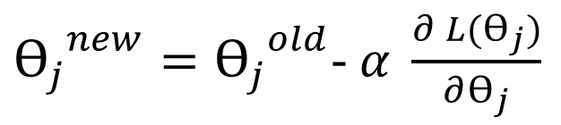

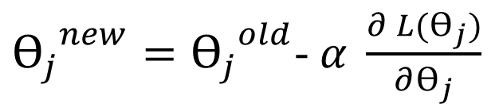
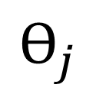

Gradient-Descent Algorithm: Why It Works ?
${ϴ_{j}}^{new}={ϴ_{j}}^{old}$- $α \frac{∂ L(ϴ_{j})}{∂ϴ_{j}}$
$L{(ϴ}_{j}$)
$$ϴ_{j}$$
${ϴ_{j}}^{new}={ϴ_{j}}^{old}$- $α \frac{∂ L(ϴ_{j})}{∂ϴ_{j}}$
$$L(ϴ_{j})$$
$$ϴ_{j}$$

Slide 18
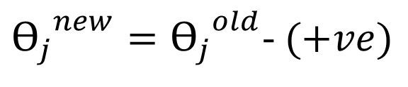
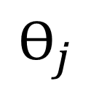
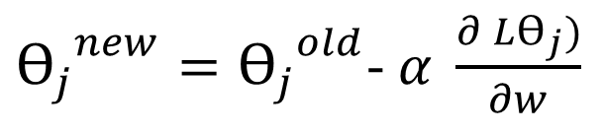

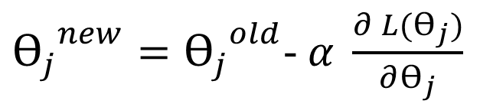
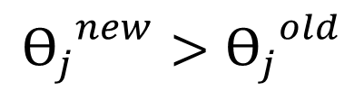

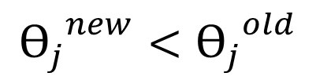

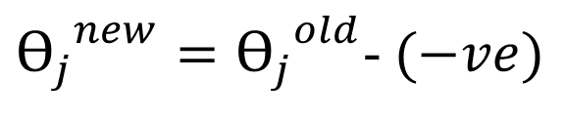
Gradient-Descent Algorithm: Why It Works ?
${ϴ_{j}}^{new}={ϴ_{j}}^{old}$- $α \frac{∂ L(ϴ_{j})}{∂ϴ_{j}}$
$$L{(ϴ}_{j})$$
${ϴ_{j}}^{new}={ϴ_{j}}^{old}$- $(+ve)$
$$ϴ_{j}$$
$${ϴ_{j}}^{new}<{ϴ_{j}}^{old}$$
${ϴ_{j}}^{new}={ϴ_{j}}^{old}$- $α \frac{∂ Lϴ_{j})}{∂w}$
$$L(ϴ_{j})$$
${ϴ_{j}}^{new}={ϴ_{j}}^{old}$- $(−ve)$
$${ϴ_{j}}^{new}>{ϴ_{j}}^{old}$$
$$ϴ_{j}$$

Slide 19
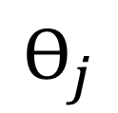

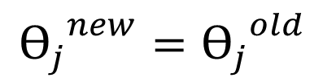
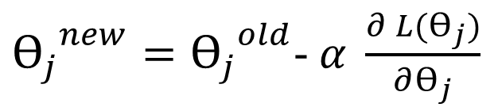
Gradient-Descent Algorithm: Why It Works ?
${ϴ_{j}}^{new}={ϴ_{j}}^{old}$- $α \frac{∂ L(ϴ_{j})}{∂ϴ_{j}}$
$$L{(ϴ}_{j})$$
$${ϴ_{j}}^{new}={ϴ_{j}}^{old}$$
Why ?
$$ϴ_{j}$$

Slide 20
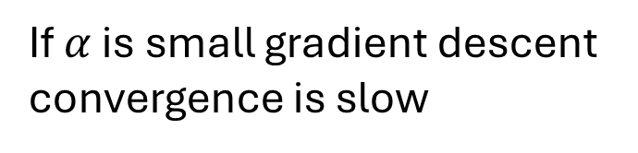
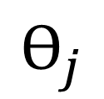
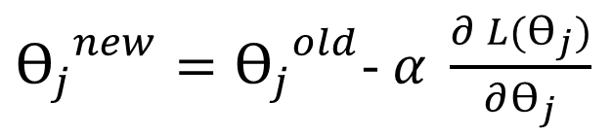

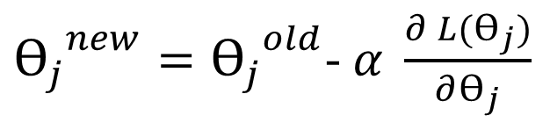
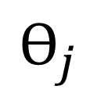
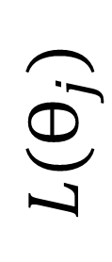
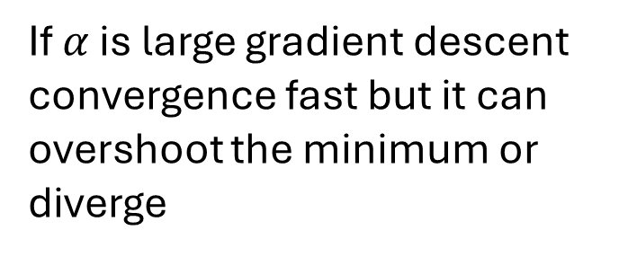
Gradient Descent Algorithm: Semantics of Learning Rate
${ϴ_{j}}^{new}={ϴ_{j}}^{old}$- $α \frac{∂ L(ϴ_{j})}{∂ϴ_{j}}$
$L(ϴ_{j}$)
If $α$ is small gradient descent convergence is slow
$$ϴ_{j}$$
${ϴ_{j}}^{new}={ϴ_{j}}^{old}$- $α \frac{∂ L(ϴ_{j})}{∂ϴ_{j}}$
$$L(ϴ_{j})$$
If $α$ is large gradient descent convergence fast but it can overshoot the minimum or diverge
$$ϴ_{j}$$

Slide 21
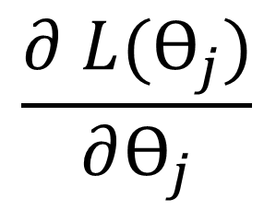

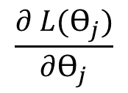

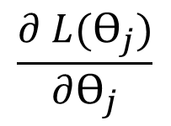
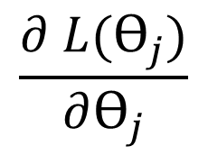
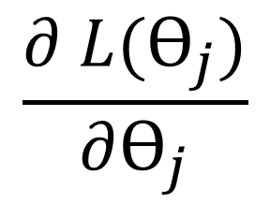
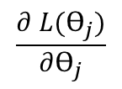
Convergence
$$\frac{∂ L(ϴ_{j})}{∂ϴ_{j}}$$
$$\frac{∂ L(ϴ_{j})}{∂ϴ_{j}}$$
$$L(ϴ_{j})$$
$$\frac{∂ L(ϴ_{j})}{∂ϴ_{j}}$$
$$ϴ_{j}$$
$$\frac{∂ L(ϴ_{j})}{∂ϴ_{j}}$$
$$\frac{∂ L(ϴ_{j})}{∂ϴ_{j}}$$
$$\frac{∂ L(ϴ_{j})}{∂ϴ_{j}}$$

Slide 22
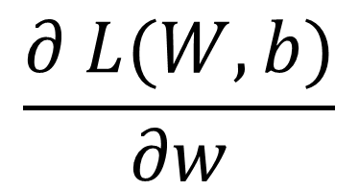

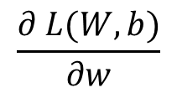
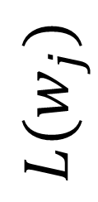
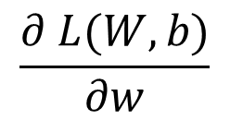
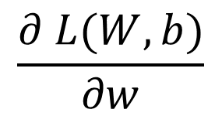
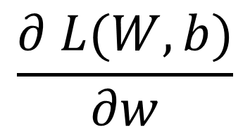

Convergence
$$\frac{∂ L(W,b)}{∂w}$$
$$\frac{∂ L(W,b)}{∂w}$$
$$L{(w}_{j})$$
$$\frac{∂ L(W,b)}{∂w}$$
$$w_{j}$$
As it approaches to local minimum, gradient descent automatically takes smaller steps
$$\frac{∂ L(W,b)}{∂w}$$
$$\frac{∂ L(W,b)}{∂w}$$
$$\frac{∂ L(W,b)}{∂w}$$

Slide 23
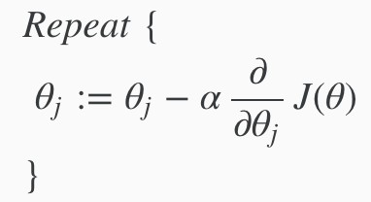
Introduction Intuition Cost Function and Gradient Descent LR with GD Python Polynomial Regression Tasks
Gradient-Descent Algorithm
$$Repeat untill convergence$$
Convergence is a name given to the situation where the loss function does not improve significantly, and we are stuck in a point near to the minima.
Regression

Slide 24
Introduction Intuition Cost Function and Gradient Descent LR with GD Python Polynomial Regression Tasks
Types of gradient Descent:
Batch Gradient Descent: This is a type of gradient descent which processes all the training examples for each iteration of gradient descent. But if the number of training examples is large, then batch gradient descent is computationally very expensive. Hence if the number of training examples is large, then batch gradient descent is not preferred. Instead, we prefer to use stochastic gradient descent or mini-batch gradient descent.
Stochastic Gradient Descent: This is a type of gradient descent which processes 1 training example per iteration. Hence, the parameters are being updated even after one iteration in which only a single example has been processed. Hence this is quite faster than batch gradient descent. But again, when the number of training examples is large, even then it processes only one example which can be additional overhead for the system as the number of iterations will be quite large.
Mini Batch gradient descent: This is a type of gradient descent which works faster than both batch gradient descent and stochastic gradient descent. Here b examples where b<m are processed per iteration. So even if the number of training examples is large, it is processed in batches of b training examples in one go. Thus, it works for larger training examples and that too with lesser number of iterations.
Regression

Slide 25
Introduction Intuition Cost Function and Gradient Descent LR with GD Python Polynomial Regression Tasks
Gradient Descent In Linear Regression
Regression

Slide 26

Now Time To Implement

Slide 27



Slide 28



Slide 29



Slide 30



Slide 31


